Slide 1
Indian Product Reviews (Predicting ratings)

Slide 2
Motive
With the given data comprising of Product reviews and rating of the Indian Products on amazon, we tend to predict the ratings of such products based on the given review by a user.

Slide 3
Purpose
The purpose of predicting ratings is to easily define a system where one could determine the consumer response to a product without going to individual review line by line.
This would save a lot of time as well as will allow us to bring in more insights on how the product is doing in different time frames by plotting ratings based on the reviews by customer.

Slide 4
Stages of project
Data Wrangling – Loading and cleaning data for pre processing.
Explorratory Data Analysis – Finding Insights from data.
Pre-Processing – Transforming data for modeling
Modeling – Testing different models on the prepared data

Slide 5
Data Wrangling
The used data is taken from Kaggle and comprises of 2778 reviews of varius Indian products listed on Amazon.
The data was fairly clean and did not had significant missing values.
We did however had to change the case of the product names to ensure fair EDA on the data.
The data was also split into Training and Testing parts to make sure that testing data remains untouched till modelling.

Slide 6
EDA(Exploratory Data Analysis)
The top 5 brand in the indian product market -
Mamaearth
Cinthol
Godrej
Himalaya
Titan

Slide 7
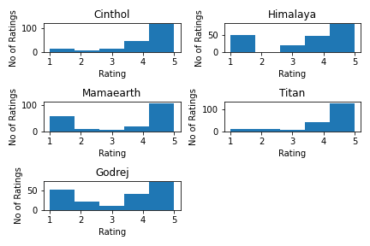
Ratings of the top 5 brands

Slide 8
...
There were a total of 22 unque brands.
EDA revealed that top 10 brands comprised 75% of the total ratings in the dataset.

Slide 9
Pre Processing
The best transformation of the data was using the count vectorizer method.
The approach of TF-IDF vectorization was also used which was later dropped during the modeling stages.

Slide 10
Modelling
The following models were used to get the best prediction results -
RandomForrestClassifier model

Slide 11
Business Challenges
How well is the product performing among consumers?
What is the trend of the product in the market?
Whether a certain change brought in a positive or negative response among the consumers?
Whether the ratio of positive to negative sentiments related to product increasing or decreasing over time?

Slide 12
Does our model provides solution?
Predicting ratings on reviews can determine the sentiments of customer.
Ratings can help us give insights like- whether the sentiment is getting positive or negative over time.
Reduces time and man power to determine the sentiment of customers.
Easy to interpret

Slide 13
Challenges Faced
Availibility of user reviews across every sentiment. Reviews biased towards a particular sentiment can effect the predictions.
Credibility of Data, whether the data provided is a genuine review and not marketed ny PR companies.
Size of the data. Small number of reviews over a product can not help in identifying the sentiment.

Slide 14
Conclusion
The Rating based prediction model is a good and easy way to identify the sentiment of the product in market. It will make it easy to interpret various business insights.
This method is a better, faster and more effective than getting insights based on reviews themselves

